Slide 1
Topic 7: Analysis of Costs

Slide 2
Economic Analysis of Costs
Total Costs: Fixed and Variable
Marginal Costs
Average Cost (Unit Cost, Fixed and variable Cost)
The Relation between Average Cost and marginal Cost
The Link between Production and Costs
Diminishing Returns and U-Shaped Cost Curves
Financial Statement
Opportunity Costs

Slide 3
Total costs
Total costs include all costs incurred when a firm produces and sells a product. In short-run , there are two types of costs.
Variable costs (costs whose total amount varies with the quantity of inputs used and output produced).
Fixed costs (costs that must be paid by the firm even if its output is zero).
In the long run, all costs are variable, since all inputs are variable.

Slide 4
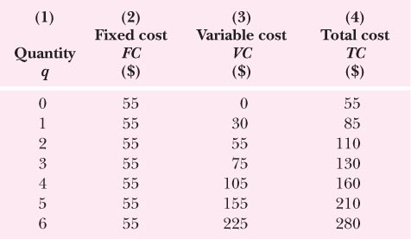
TC, TFC & TVC

Slide 5
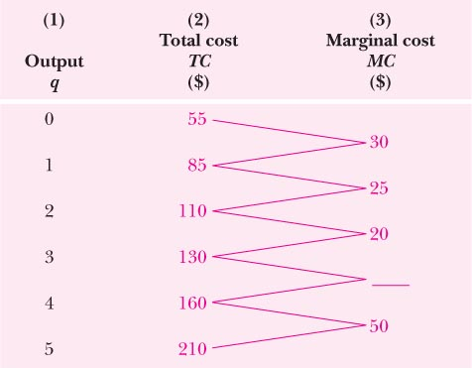
Calculation of Marginal Cost

Slide 6
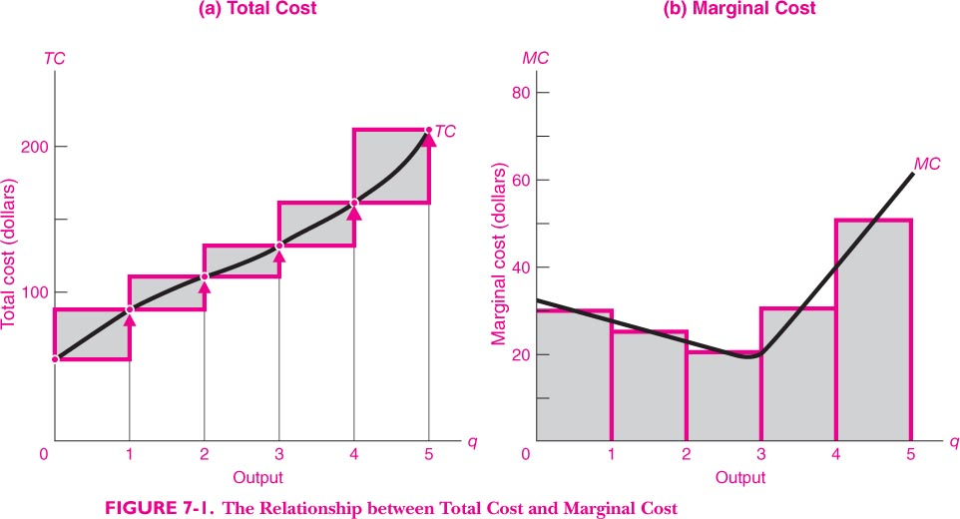
Relationship between Total and Marginal cost

Slide 7
Link between Production and Costs
The law of diminishing returns also deals with the nature of a firm’s costs. As the firm increases production, additional variable inputs are added to a fixed capital base; as marginal product begins to fall, marginal costs will begin to rise. Cost curves are U-shaped when short-run returns increase in the early range of production but eventually start rising as output increases and more of the variable inputs are employed.

Slide 8
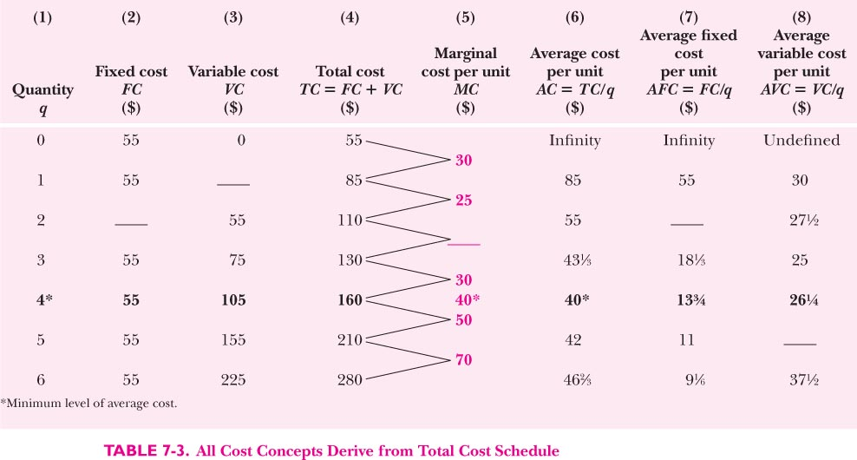
Relationship between Various Concepts of Costs

Slide 9
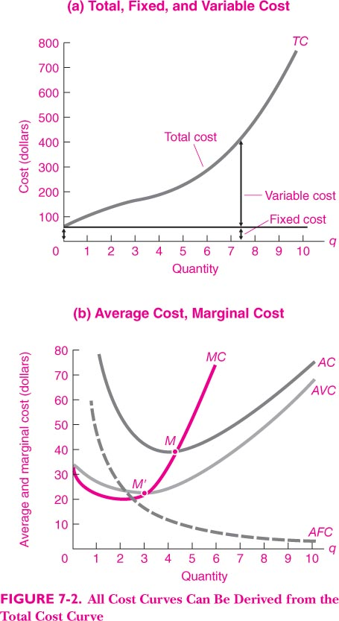

Slide 10
Relationship between MC and AC
MC is equal to AC when the latter is at its minimum.
i) When MC < AC, it pulls the AC down.
ii) When MC = AC, AC does not rise or fall and hence, MC = min AC.

Slide 11
Financial Statement
Balance Sheet statement: Assets and Liabilities, at a point of time, stock concept (e.g. on 31st March of a year)
Profit and Loss statements: Profits and Losses over a period of time (say over a financial year), flow concept

Slide 12
Opportunity Costs
Economist's concept of cost. VALUE OF GOODS/SERVICES FORGONE AS A RESULT OF TAKING A DECISION.
Opportunity costs do not show up in financial statements of a firm. They are behind these statements. Accountant takes into account only realized exchanges whereas economists compare the cost-benefits of alternative decisions. In well-behaved markets, price reflects the opportunity costs.

